Slide 1
IBM APPLIED DATA SCIENCE CAPSTONE PROJECT
Which city would be best to open up a restaurant and what type of restaurant should one open?

Slide 2
Which city would be best to open up a restaurant and what type of restaurant should one open?"
The project intends to answer this question.
In particular, does it make sense to establish a Halal restaurant in Seoul?

Slide 3
METHODOLOGY
1
Data retrieval and cleaning
First stage of the project will focus on retrieving data from the data sources and clean the data so that they can be processed with Pandas data frame. Data was scrapped using BeautifulSoup4. Scrapped data usually contains unneeded characters and signs and should be cleaned.
2
Venue query in a target location
Second stage of the project will focus on retrieving geolocation data from Foursquare and look for restaurants in the target city. The project will count the number of restaurants, broken down into categories. The project will determine a type of restaurant that is least present in the area.
3
Look for opportunities
Third stage of the project will seek for additional information that will reinforce the recommendation for a restaurant in the area from the above.

Slide 4
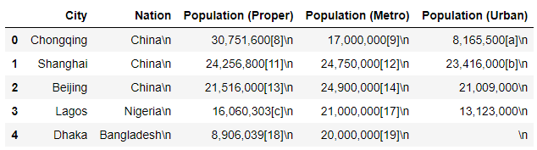
Initial data retrieval from wikipedia
Scrapped data requires cleaning
Special care should be taken to also remove hidden non-UTF characters in the string

Slide 5
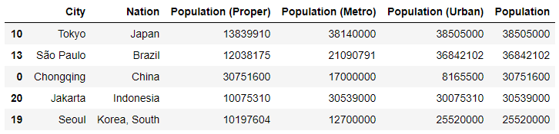
Cleaning data
Data cleaned and column types corrected for mathematical computations
Notice that the population columns are now showing as integers

Slide 6
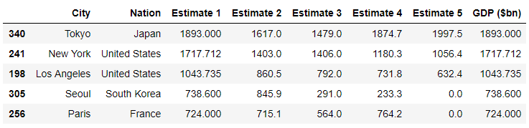
Adding more data
Cities’ GDP data has been downloaded and cleaned
Every city has at least 1 data from the 5 estimates

Slide 7
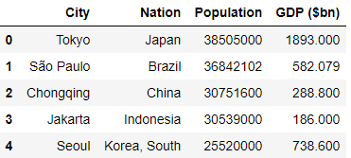
Merging dataframes
Dataframe was merged between population and GDP
Needs careful analysis of data to verify that the city and nation names are identical between the two data frames

Slide 8
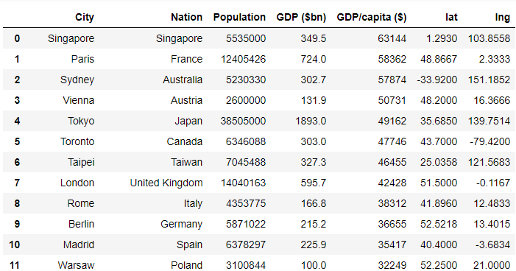
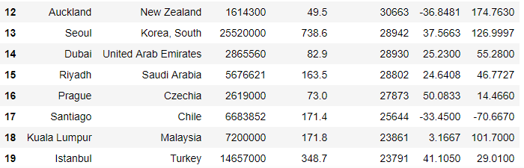
Adding geospatial data for cities
Data downloaded from https://simplemaps.com/data/world-cities to retrieve the latitude and longitude coordinates for each major cities for the top 20 cities with the highest GDP per capita in US$

Slide 9
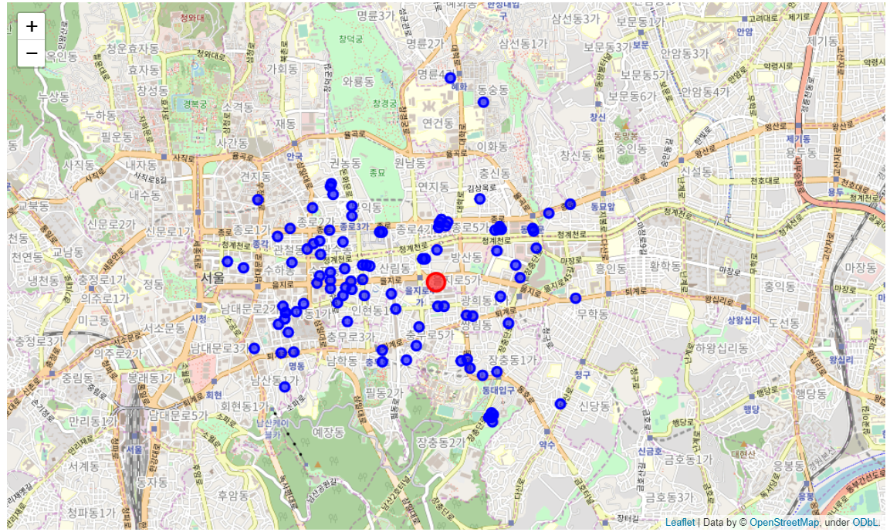
Retrieving venues related to food from Foursquare
Seoul was selected randomly for further analysis
Blue dots show locations for 50 food related venues retrieved from Foursquare query
Red dot depicts the central point for Seoul’s coordinate

Slide 10
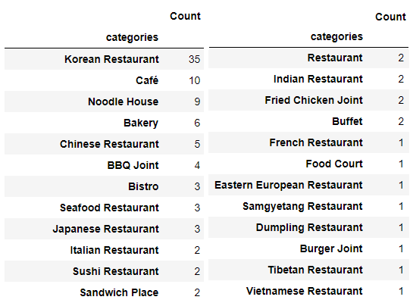
The initial result
Most international food restaurants are present from the query
Notice that there are no Islam food restaurants in this list
It may be due to the lack of demand, or could this be a sign for opportunity?

Slide 11
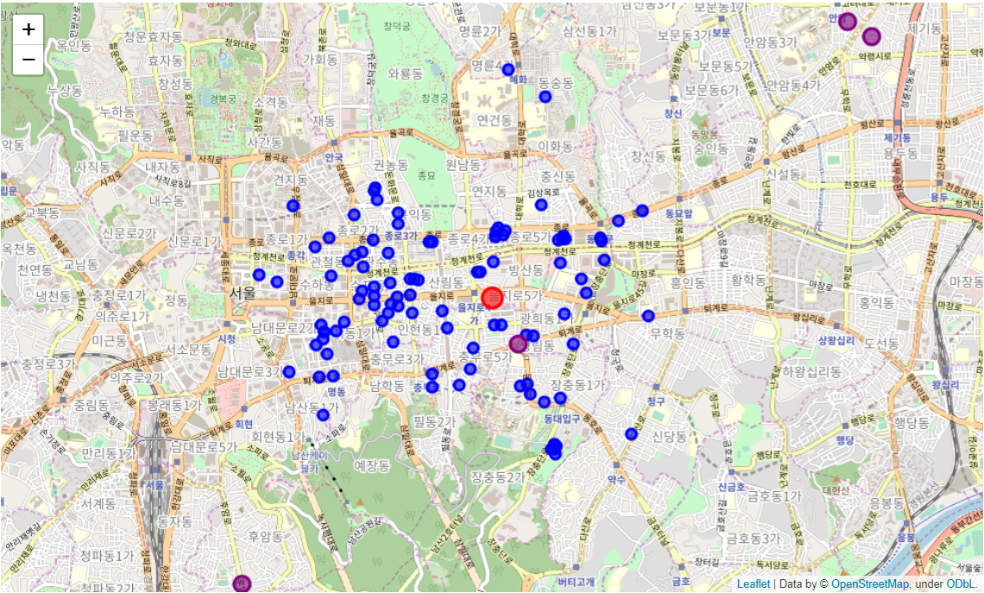
Conclusion
It turns out that there are two mosques within the vicinity of the search area and five when you consider distance of 30 minutes’ car drive
The project concludes that there is potential for prospective investors or entrepreneurs to open up a Halal food restaurant in Seoul in the norther district

Slide 12
Thank you

